Slide 1
ANSI SQL
Data Definition Language (DDL) Statements

Slide 2
Context Setting: Overview
The session on DDL provides knowledge and understanding of the various database-centric operations with the help of a case study using ANSI SQL syntax.
2

Slide 3
Enabling Objectives
After completing this chapter, in the next 60 minutes you will be able to :
Create at least 1 table using Data Definition Language(DDL) statement.
Modify or Drop at least 1 table structure created using DDL statement
3

Slide 4
Key Topics
CREATE Statement
ALTER Statement
DROP Statement
TRUNCATE Statement
GRANT and REVOKE Statement
Notes:
CREATE – Creates objects in the database ALTER – Alters objects of the database DROP – Deletes objects of the database TRUNCATE – Deletes all records from a table and resets table identity to initial value.

Slide 5
Scenario
For the complete understanding of ANSI SQL, we are going to make use of Product Management System (PMS) for ABC Traders.
ABC Traders is a company which buys collectable model cars, trains, trucks, buses, and ships directly from manufacturers and sell them to distributors across the globe. In order to manage the stocking, supply, and payment transactions, the above mentioned software is developed.
As per the requirement of the trading company, an inventory system is developed to collect the information of the products, customers, and their payment processing.
4

Slide 6
Database Tables
There are many entities involved in Product Management System.
We will be dealing with PMS throughout this session.
Offices
To maintain information of offices, for example, office code, address, city, and so on.
Customer
To maintain customer details, for example, customer name, address, and so on.
Employees
To maintain employee
details, for example, ID,
name, and so on.
Products
To maintain information of products, for example, product id, name, and so on.
Payments
To maintain information of payments done, for example, payment date, amount, and so on.
Orders
To maintain Orders done by customers, for example, order no, date, and so on.
Order Details
To maintain Orders done by customers, for example, order no, date, and so on.

Slide 7
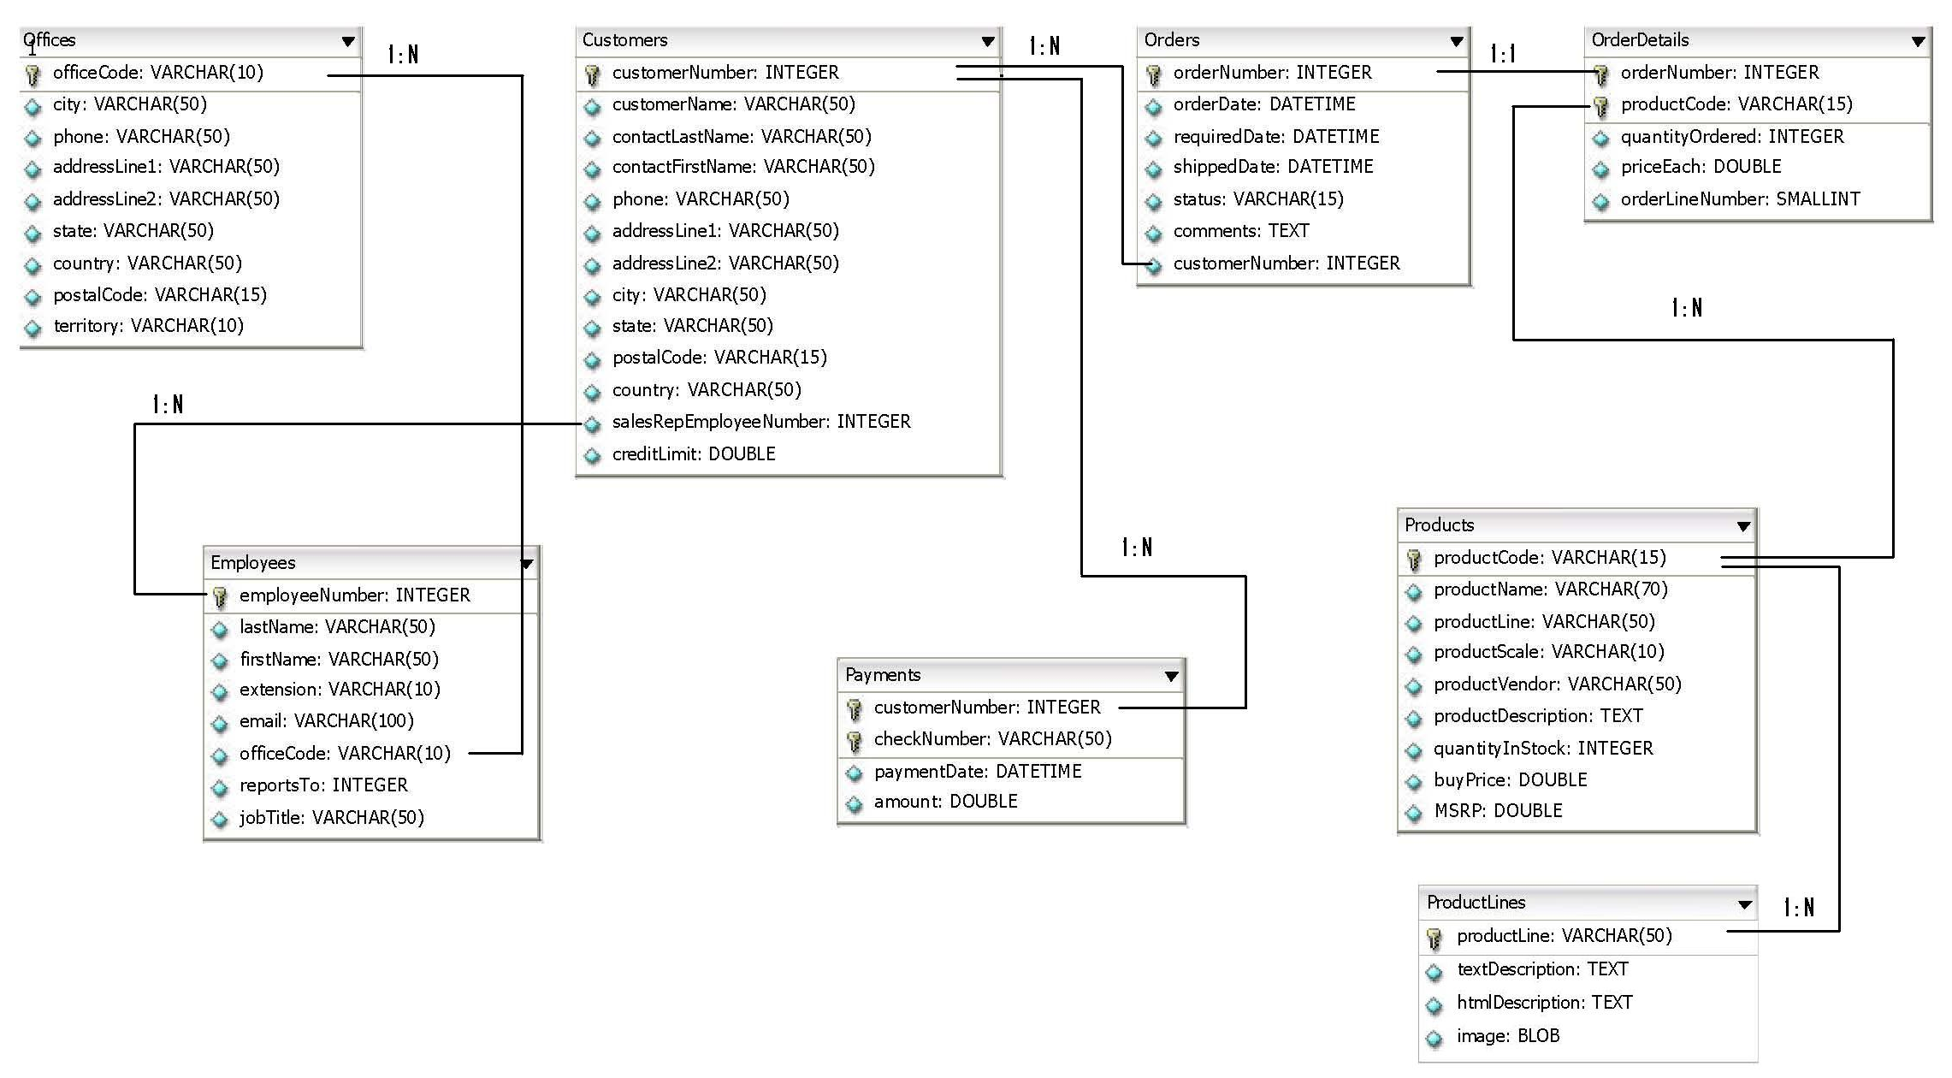
Schema Diagram
6

Slide 8
CREATE Statement

Slide 9
CREATE Statement
Requirement
How to create the database “ABCTradersPMSDB“ for PMS System.
Query:
CREATE DATABASE ABCTradersPMSDB;
8
Notes:
Explanation:
The query will create a Database with name ABCTradersPMSDB

Slide 10
CREATE Statement
Creating database is a core task as it must signify the meaning of its existence.
Best practices to follow while naming database or database objects:
Use plain English e.g. XDSFFBUS (Bad name)
Include an indication of the object type in the name e.g. TrainingDB
Avoid using spaces e.g. Feedback System
Avoid names that will become outdated e.g. Training 2018
Avoid using special characters/symbols e.g. Training@2018
Avoid using numbers in names e.g. Training007
8
Notes:
Creating database is a core task as it must signify the meaning of its existence.
Tim needs to be told about the best practices which we will follow while naming database or database objects.
Explanation:
The query will create a Database with name ABCTradersPMSDB

Slide 11
CREATE DATABASE
This command is used to create database which is the primary part of any database system.
Database will hold various database objects, for example, table, views etc.
Syntax :
CREATE {DATABASE | SCHEMA} db_name
CREATE {DATABASE | SCHEMA} [IF NOT EXISTS] db_name [create_specification] ...
36

Slide 12
CREATE Statement
Requirement
How to create a table with the name PMSOffices.
Query:
CREATE TABLE PMSOffices
(
officeCode VARCHAR(10) ,
city VARCHAR(50) ,
phone VARCHAR(50) ,
addressLine1 VARCHAR(50) ,
addressLine2 VARCHAR(50) ,
state VARCHAR(50),
country VARCHAR(50) ,
postalCode VARCHAR(15)
)
8
Notes:
Explanation:
The query will create a Database with name ABCTradersPMSDB

Slide 13
CREATE Statement
Creates a table with the given name.
Require CREATE permission(called privilege) for the table.
Can create table in a specific database.
The table name can be specified as db_name.tbl_name
This works regardless of a default database, assuming that the database exists.
Syntax:
CREATE [TEMPORARY] TABLE [IF NOT EXISTS] tbl_name
(create_definition,...)
[table_options]
[partition_options]
[select_statement]
38

Slide 14
ALTER Statement

Slide 15
ALTER Statement
Requirement
How to add a missed column in a table.
Query:
ALTER TABLE PMSOffices
ADD COLUMN territory VARCHAR(10);
8

Slide 16
ALTER Table
Changes the table structure like
Add or Delete columns
Create or destrpy indexes
Change datatype of a column.
Rename Column or Table name.
Syntax :
ALTER TABLE tbl_name
[alter_specification , alter_specification ...]
41

Slide 17
RENAME Statement

Slide 18
RENAME Statement
Requirement
How to rename a table.
Query:
RENAME TABLE PMSOffices TO Offices;
8

Slide 19
RENAME Table
This statement renames one or more tables.
The rename operation is done automatically, which means that no other session can access any of the tables while the rename is running.
Syntax :
RENAME TABLE tbl_name TO new_tbl_name
41

Slide 20
RENAME Table
To rename an existing table.
Create a new empty table with same structure.
Take backup of old table
Rename the new table with existing table.
Query
CREATE TABLE new_table(…);
RENAME TABLE old_table TO backup_table,
new_table TO old_table;
44
Notes:
If you have an existing table old_table, you can create another table new_table that has the same structure but is empty, and then replace the existing table with the empty one as follows (assuming that backup_table does not already exist)

Slide 21
RENAME Table
Rename more than one table
Renaming operations are done from left to right.
Query: swap two table names
RENAME TABLE old_table TO tmp_table,
new_table TO old_table,
tmp_table TO new_table;
44

Slide 22
RENAME Table
Move table from one database to another
As long as two databases are on the same file system, you can use RENAME TABLE to move a table from one database to another:
Query:
RENAME TABLE current_db.tbl_table TO other_db.tbl_table
44

Slide 23
DROP, TRUNCATE Statement

Slide 24
DROP TABLE
Removes one or more tables.
Require DROP privilege for each table.
All table data and the table definition are removed when the table is dropped.
Syntax:
DROP TABLE tbl_name [RESTRICT | CASCADE]
46

Slide 25
RENAME Statement
Requirement
How to remove PMSOffices table completely from database
Query:
DROP TABLE PMSOffices;
8

Slide 26
TRUNCATE TABLE
Empties a table completely.
It requires the DROP privilege.
Query:
TRUNCATE TABLE PMSOffices;
Syntax :
TRUNCATE [TABLE] tbl_name
47
Notes:
Important Information
Logically, TRUNCATE TABLE is similar to a DELETE statement that deletes all rows, or a sequence of DROP TABLE and CREATE TABLE statements .
TRUNCATE is faster and does not use as much undo space as a DELETE.

Slide 27
Data Control Language
(GRANT, REVOKE)

Slide 28
Data Control Language
Requirement
To make DB more secure. Restrict users from performing various DB operations.
Create user Jack with password ‘pass@123’ who must be granted CREATE privilege so that he can create database.
Query:
CREATE USER jack IDENTIFIED BY 'pass@123' ;
GRANT CREATE ON *.* TO 'jack';
CREATE Database TrainingFeedbackDBTemp;
8
Notes:
Creating User jack with Password ‘pass@123’
CREATE USER jack IDENTIFIED BY 'pass@123' ;
Granting Jack CREATE permission
GRANT CREATE ON *.* TO 'jack';
After Jack logs in using his credentials, let him CREATE a database
CREATE Database TrainingFeedbackDBTemp;

Slide 29
Data Control Language
Command to take away CREATE permission from jack
REVOKE CREATE ON *.* FROM 'jack';
If required, the permission can be taken back from jack in future.
49

Slide 30
Data Control Language
GRANT to allow specific users to perform specific tasks
REVOKE to cancel previously granted or denied permissions
GRANT
ANSI Syntax:
GRANT privilege_name ON object_name TO {user_name |PUBLIC |role_name} [WITH GRANT OPTION];
REVOKE
ANSI Syntax:
REVOKE privilege_name
ON object_name
FROM {user_name |PUBLIC |role_name}
50
Notes:
NOTE
To use the first REVOKE syntax, you must have the GRANT OPTION privilege and you must have the privileges that you are revoking.
REVOKE removes privileges, but does not drop table entries. To remove a user account entirely, use DROP USER or DELETE.
You must create user first in order to grant or revoke privileges from them.

Slide 31
Practice Check
Refer RIO_02_DDL_DML_DCL Lend A Hand.ppt document file
31

Slide 32
RECAP
The key points covered in this session are:
Create at least 1 table using Data Definition Language(DDL) statement.
Modify or Drop at least 1 table structure created using DDL statement
65

Slide 33

Source
http://en.wikipedia.org/wiki/Data_definition_language
http://en.wikipedia.org/wiki/Data_manipulation_language
http://en.wikipedia.org/wiki/Data_control_language
http://en.wikipedia.org/wiki/Transaction_Control_Language
Disclaimer: Parts of the content of this course is based on the materials available from the Web sites and books listed above. The materials that can be accessed from linked sites are not maintained by Cognizant Academy and we are not responsible for the contents thereof. All trademarks, service marks, and trade names in this course are the marks of the respective owner(s).
66

Slide 34
You have successfully completed the session on DDL, DCL Statements
67

